Slide 1
Motor Control

Slide 2
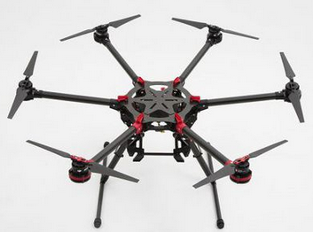
Motor Control
Multicopter consists of a multiple arms going from the center of multicopter and lying on the one plane. At the end of each arm there is a motor with propeller which can produce thrust in the direction aligned with this rotational axis.
By changing the speed of individual motors we can generate total thrust and torque and thus control the movement of the multicopter. So the only control input is array of speeds (or thrusts) of motors. The size of this array depends on the number of motors on the multicopter.

Slide 3
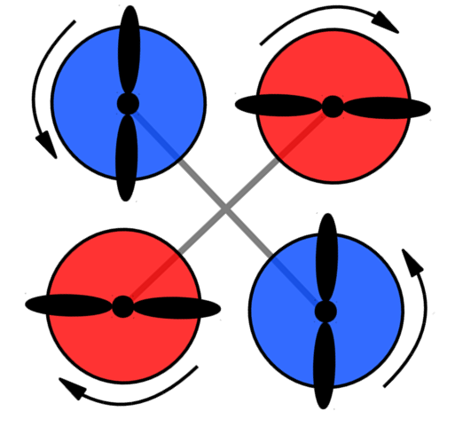
Yaw Rotation
Each of the rotors on the quad-copter produces both thrust and torque. Given that the front-left and rear-right motors both rotate counter-clockwise and the other two rotate clockwise, the net aerodynamic torque will be zero.

Slide 4
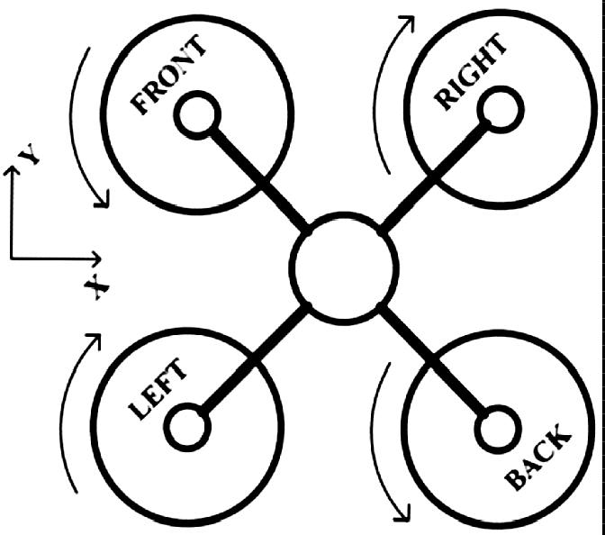
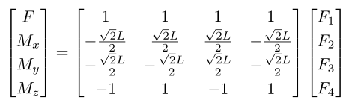
Model of Quad-copter
For a specific multicopter direct relationship between thrusts of propellers and total thrust and torque vector can be computed in a simple way.
where L is a length of arms, Fi is thrust of x-th propeller, F is a total thrust, Mi is torque around i-axis.

Slide 5
Task5
由四轴推算到六轴电机控制公式并应用

